Slide 1


Slide 2
CSE-2 (BATCH-2)
TEAM-3
S.NO | ROLL NO | Name
1. | 324103210112 | VEERA LAKSHMI
2. | 324103210113 | K.ARAVINDA KRISHNA
3. | 324103210114 | L.JAHNAVI
4. | 324103210115 | M.RAGA BHARGAVI
5. | 324103210116 | MADHUMITA PALLA
6. | 324103210117 | M.JYOTHSNA
7. | 324103210118 | M.SONIYA
8. | 324103210119 | M.SRI VARSHINI

Slide 3

BUDDHISM

Slide 4

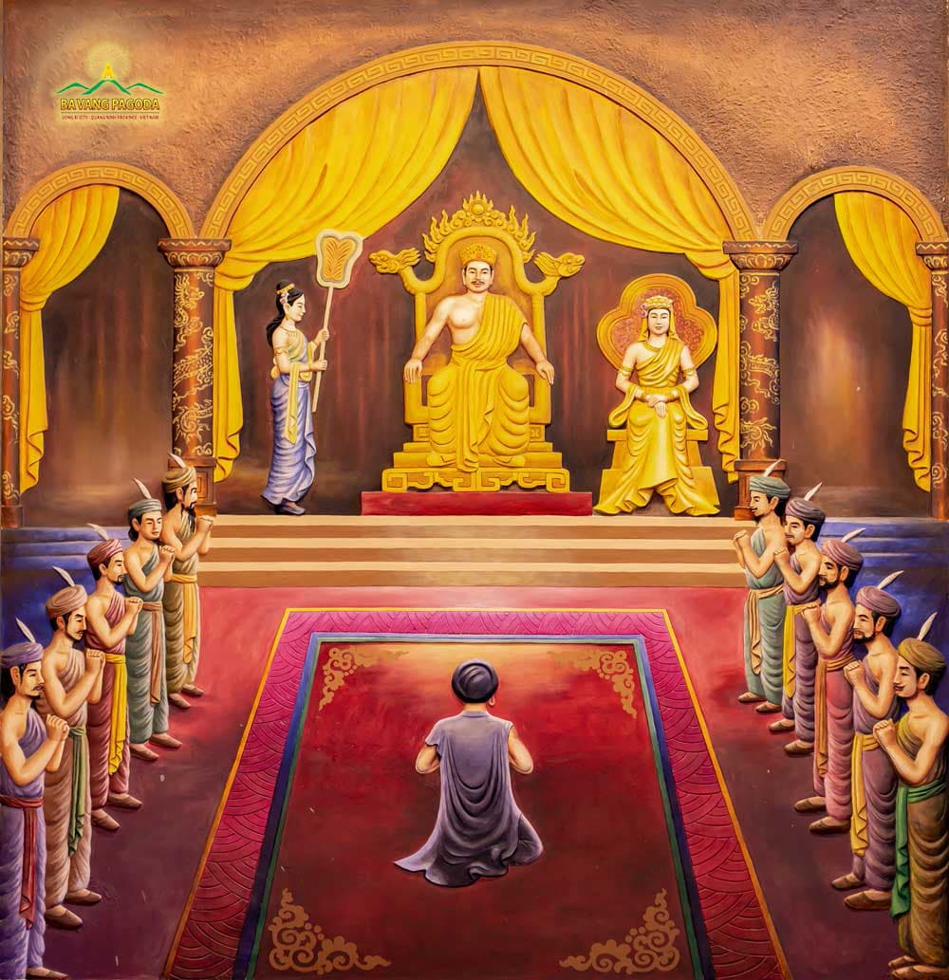
Introduction to the Life of Buddha
Early Life (563 BCE – 547 BCE)

Slide 5
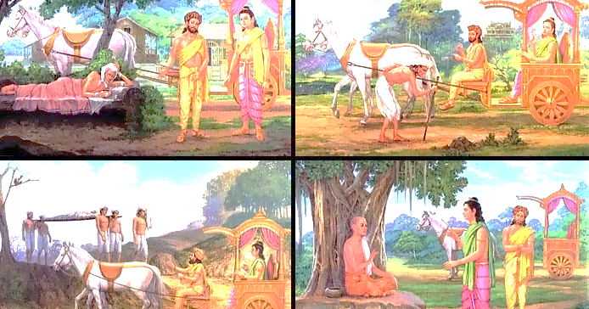
The Four Sights
THE FOUR SIGHTS
An old man:
A sick man:
A corpse:
A wandering Ascetic:

Slide 6
The Renunciation (547 BCE – 535 BCE)
The Enlightenment (535 BCE)
The Teaching Period (535 BCE – 483 BCE)

Slide 7

THE FOUR NOBLE TRUTHS

Slide 8
The First Noble Truth: The Truth of Suffering(Dukkha)
The Second Noble Truth :The Origin of Suffering(Sam Udaya)

Slide 9
The Third Noble Truth : The Cessation of Suffering(Nirodha)
The Fourth Noble Truth: The Path to the Cessation of Suffering(Magga)

Slide 10
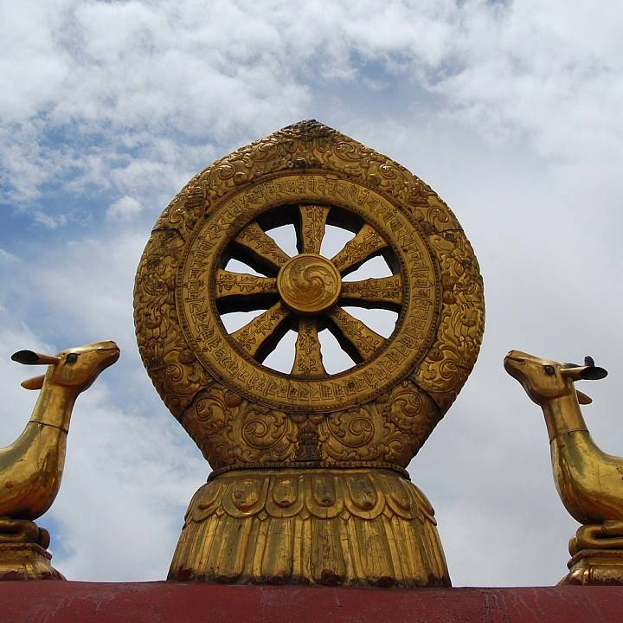
THE EIGHT FOLD PATHS
1. Right Understanding (Samma Ditthi)
2. Right Intention (Samma Sankappa)

Slide 11

3. Right Speech(Samma Vaca)
4.Right Action( Samma Kammanta)

Slide 12
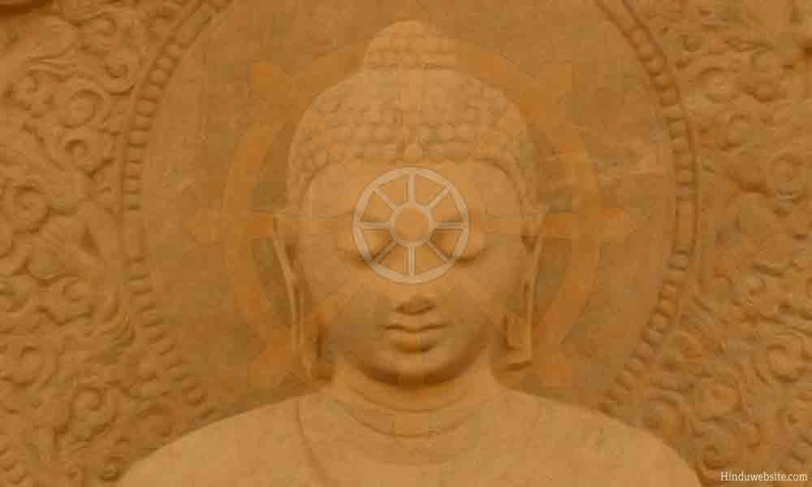
5. Right Livelihood( Samma Ajiva)
6. Right Effort(Samma Vayama)

Slide 13
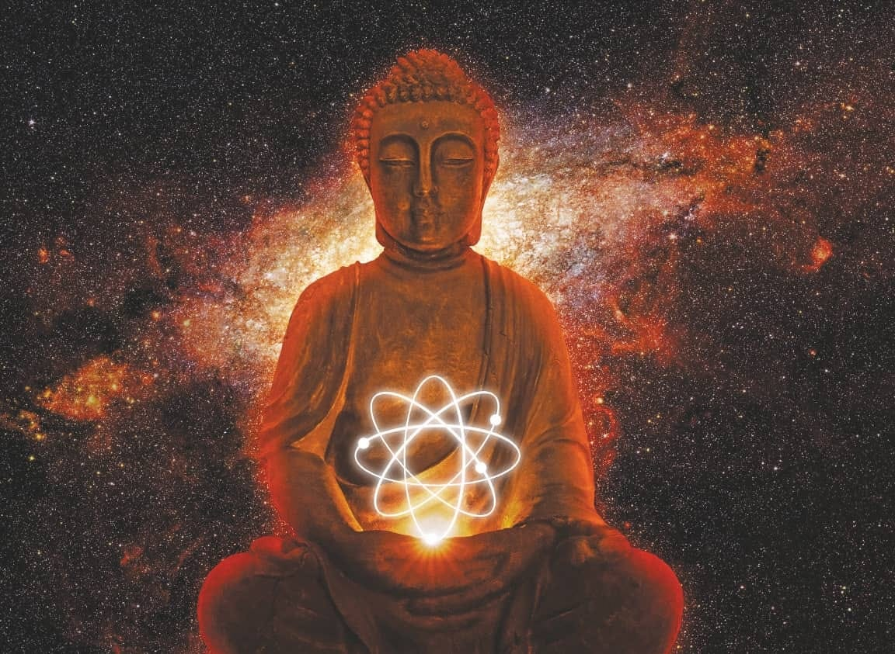
7. Right Mindfulness( Samma Sati)
8. Right Concentration( Samma Samadhi)

Slide 14
KARMA AND REBIRTH
Karma and Rebirth
KARMA AND REBIRTH
What is Karma?

Slide 15
Types of Karma
Sanchita karma
Kriyamana Karma
Agami Karma
Laws Of Karma

Slide 16
REBIRTH

Slide 17
The Six Realms of Rebirth
Hell Realm
Animal Realm
Human Realm
Demi God Realm
God Realm
Hungry Ghost Realm
Process of Rebirth

Slide 18

BUDDIST MEDIS
BUDDHIST MEDITATION AND
MINDFULNESS
What is meditation?

Slide 19
Types of Meditation
Mindfulness
Loving-kindness
concentration
insight

Slide 20

MINDFULNESS

Slide 21

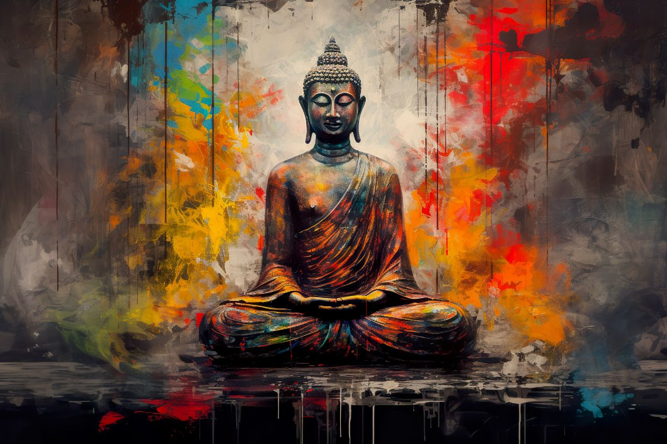
BENEFITS

Slide 22

BUDDIHST ETHICS AND MORALITY
BUDDIHIST ETHCIS

Slide 23
THE FIVE PRECEPTS
1. Abstain from harming living beings(non-violence)
2. Abstain from taking what is not given (honesty)
3.Abstain from sensual misconduct(chastity)
4.Abstrain from false speech(truthfulness)
5.Abstrain from intoxicants

Slide 24
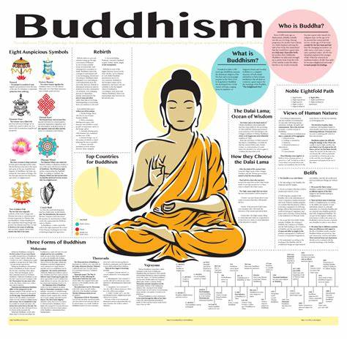
Key Principles of Buddhist Ethics
1.Non harming(ahimsa)
2.Mindfulness
3.Karma
4.Wisdom

Slide 25
Benefits of Buddhist ethics
1. Improves mental health
2. Better relationship
3.Provides moral frame work
4. Increases sense of responsibility

Slide 26

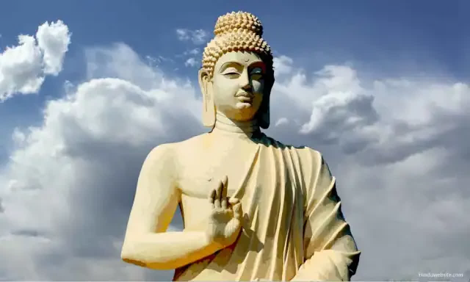
Buddhism in morality

Slide 27
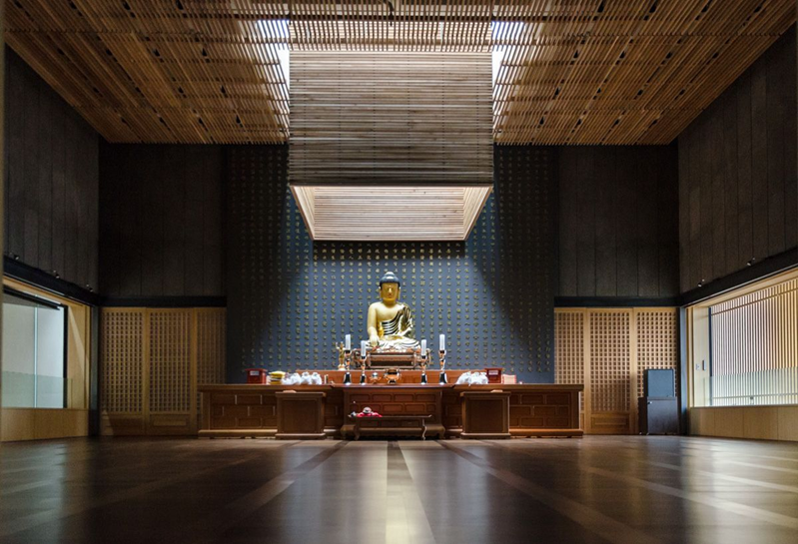
BUDDHISM IN MODERN TIMES
MODERN BUDDHIST MOVEMENTS

Slide 28
CHALLENGES AND OPPORTUNITY IN BUDDHISM

Slide 29
TECHNOLOGY AND BUDDIHSM

Slide 30
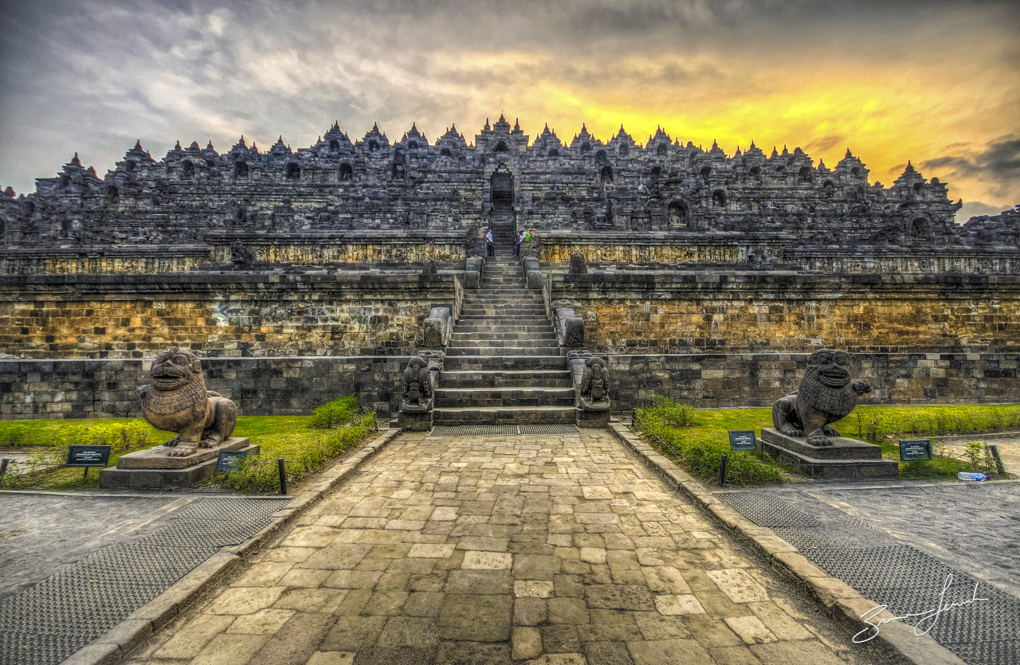

Slide 31
ANY QUERIES?

Slide 32


